Slide 1


Renew your RWVP early
Registration to Work with Vulnerable People
Registration to Work with Vulnerable People
Department of Justice
Insert your logo here

Slide 2
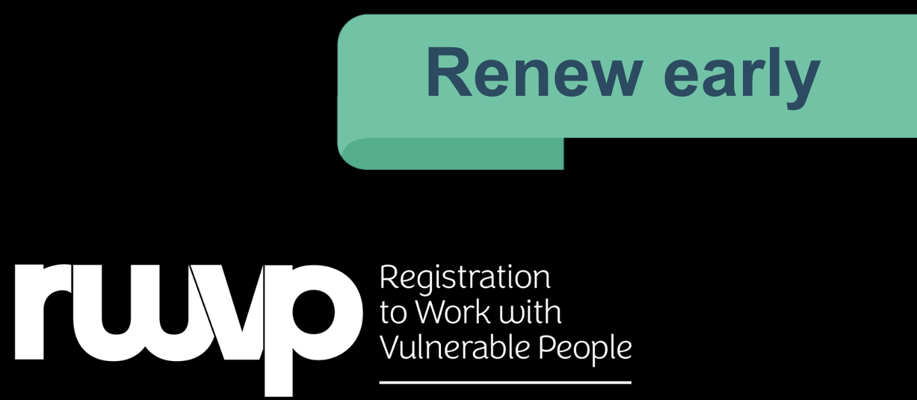
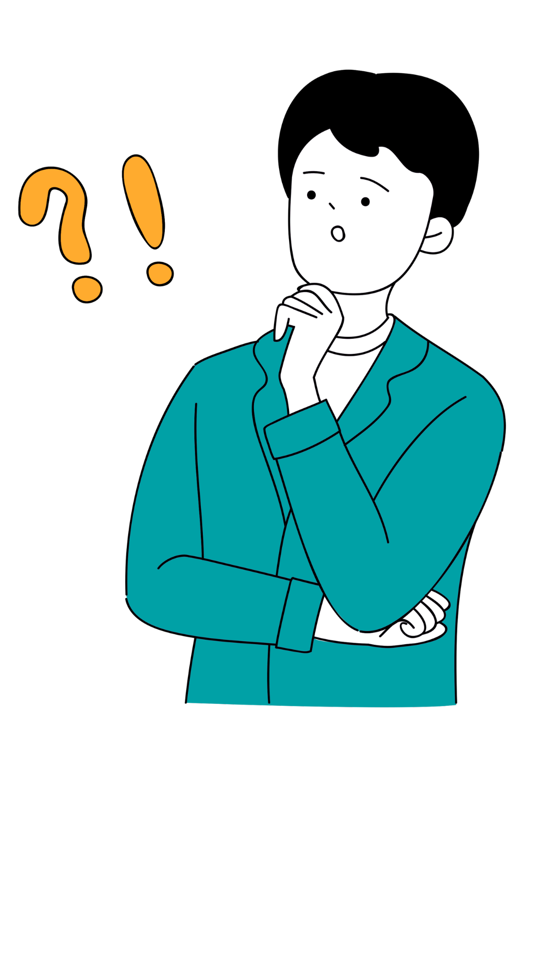
Renew your RWVP early
Right now, thousands of workers and
volunteers in Tasmania need to
renew their Registration to Work with
Vulnerable People (RWVP).
These high volumes mean it may take
longer than the usual 6 weeks for your
RWVP renewal to be processed.

Slide 3
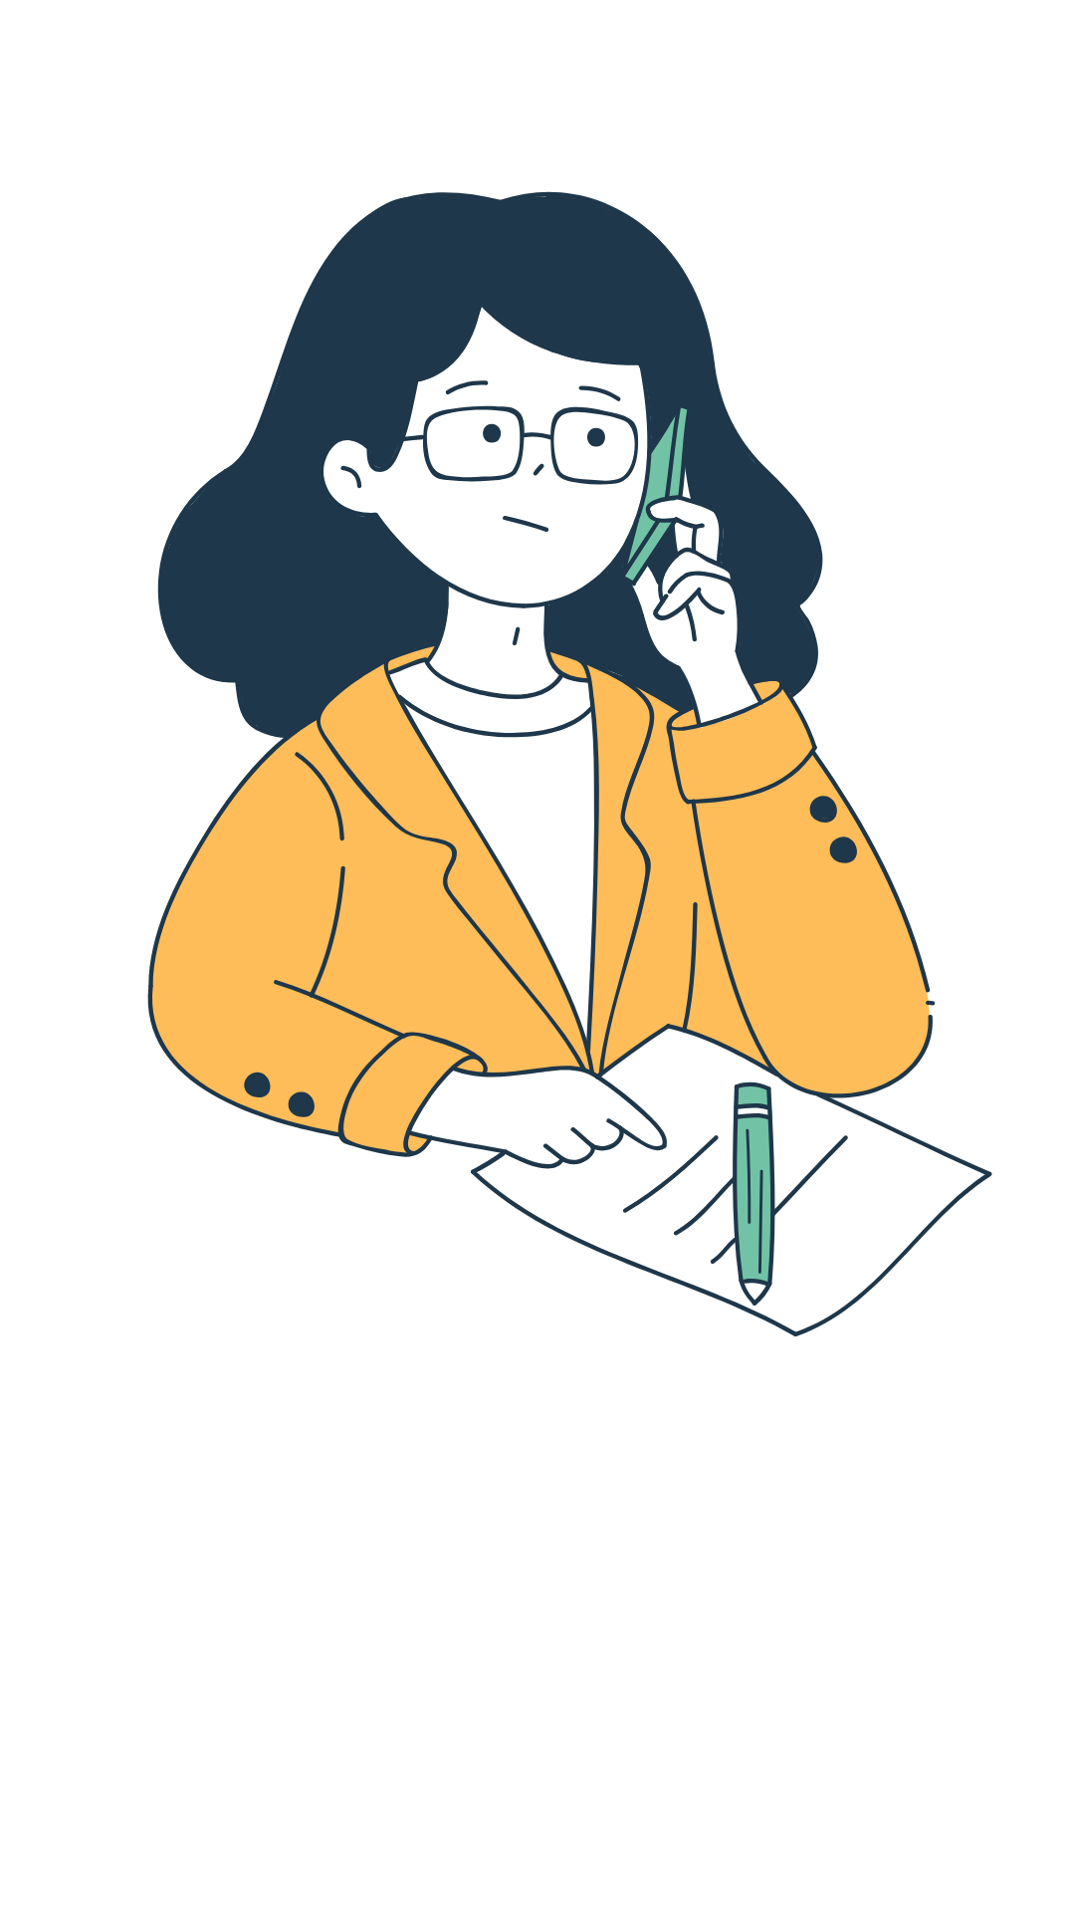
Renew your RWVP early
Renewing at the last minute means you run the risk of your RWVP expiring.
Without a current RWVP, you will not be able
to keep working or volunteering with vulnerable people, including children.

Slide 4

Renew your RWVP early
So we’re encouraging you to
renew your RWVP early —
up to 3 months before it expires.

Slide 5
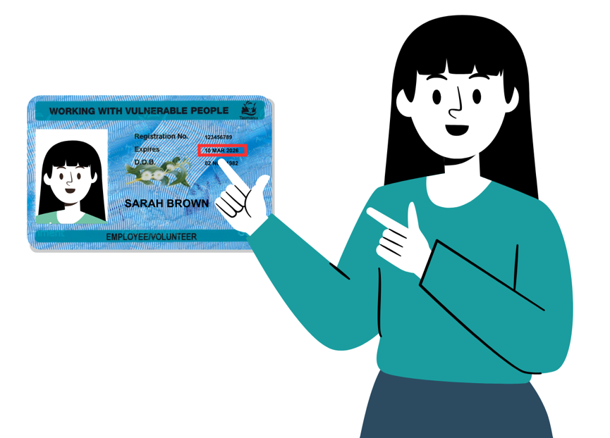
Renew your RWVP early
Check your RWVP card
to see when it expires
Jump onto MyRWVP and
renew early at
justice.tas.gov.au/rwvp/my-rwvp

Slide 6

Renew your RWVP early
You will get reminders from the RWVP Scheme by email and/or text.
You can renew your RWVP up to
3 months before it expires.
It will take effect from the date
your current RWVP expires.

Slide 7

Renew your RWVP early
Thank you for playing your role
to safeguard vulnerable people, including children, in our community.

Slide 8


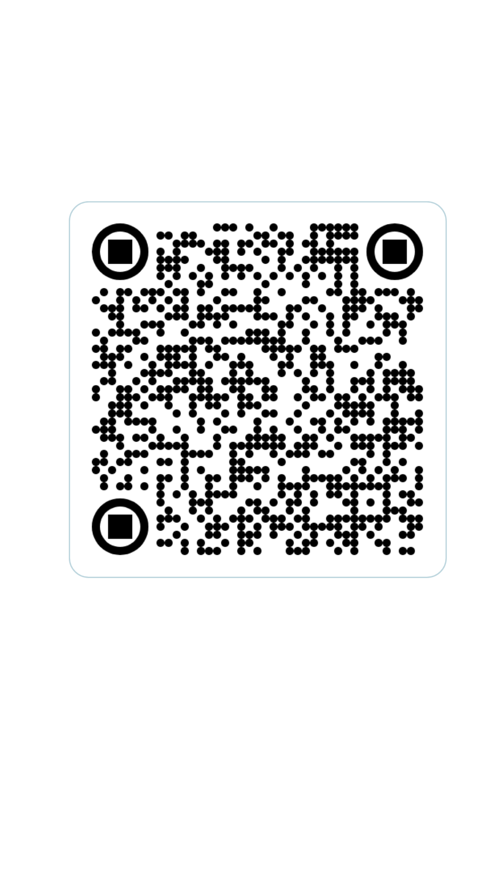



Contact us
Email us at:
<insert your Human Resources or appropriate RWVP contact>
Visit the RWVP website at: justice.tas.gov.au/rwvp/my-rwvp
Speak to someone directly:
<insert your Human Resources or appropriate RWVP contact>
Phone: <insert your appropriate RWVP contact number>

Slide 9

Questions?

